Slide 1
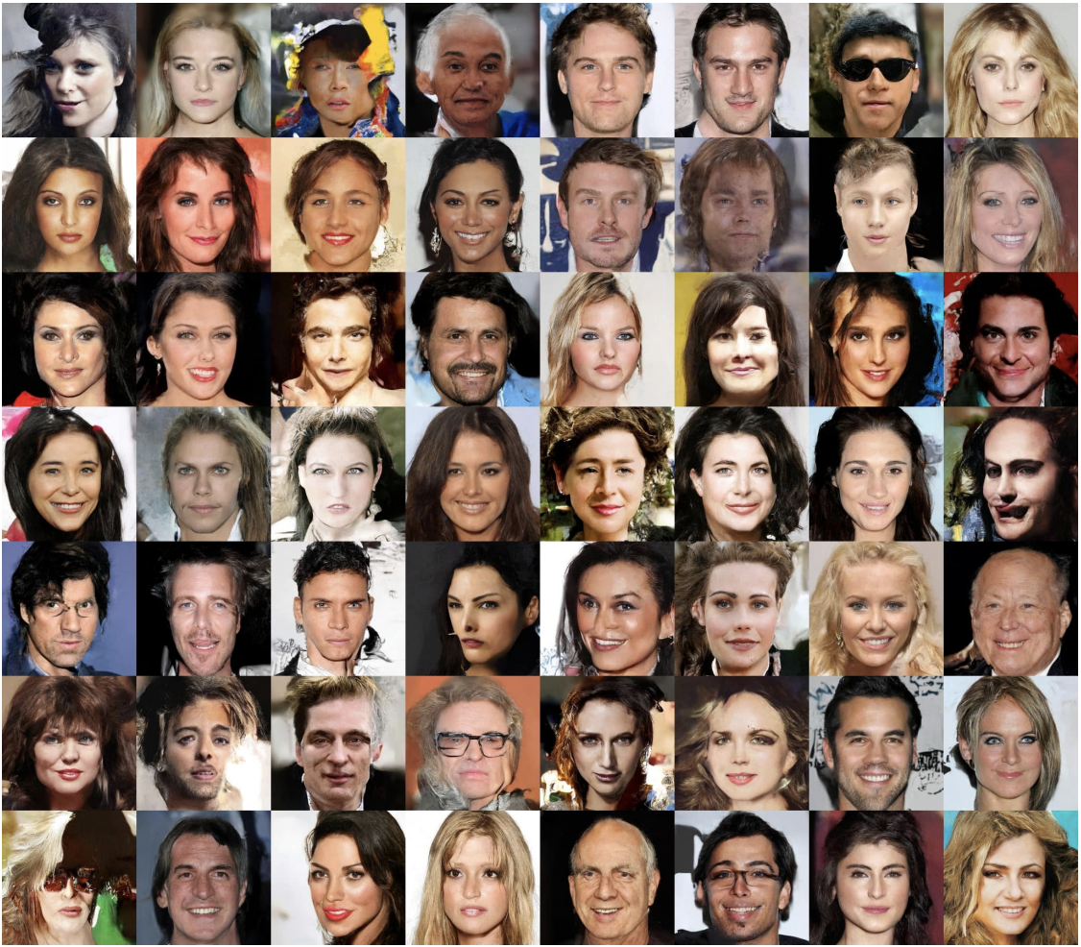
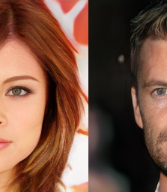
Facial GANs and Facial Expressions
A Capstone Project by Lawrence Quesada

Slide 2
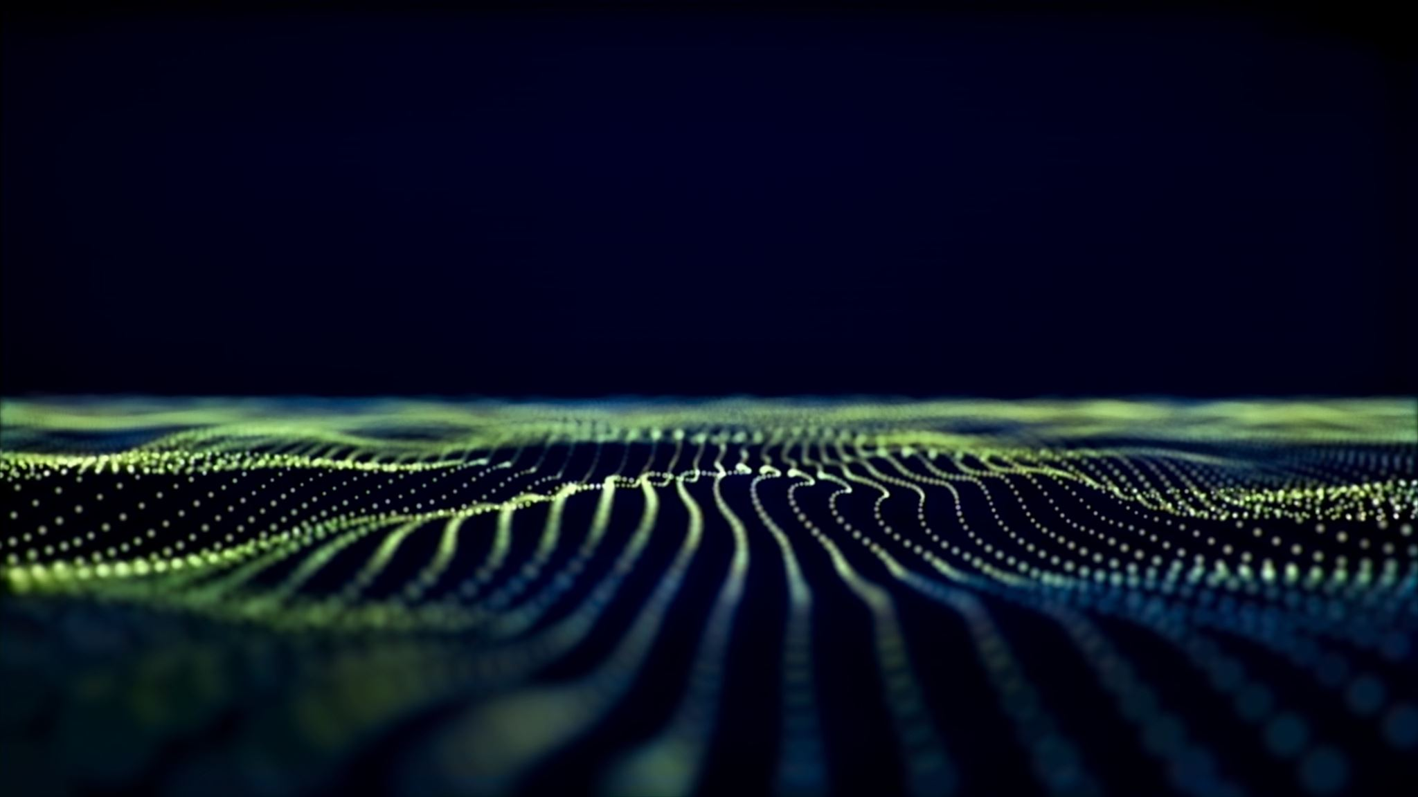
Contents
The Dataset
01
Exploratory Data Analysis
02
Pre-Processing
03
Building the Model
04
Conclusion
05
Target Audience
06
Future Considerations
07

Slide 3



data source
https://susanqq.github.io/UTKFace/
The UTKFace image dataset is available for non-commercial research purposes only. It is maintained by ssusanqq
Contact information for any questions with regards to the dataset are Yang Song and Zhifei Zhang.

Slide 4
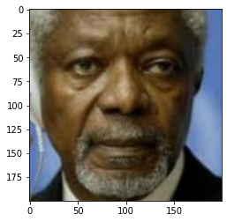
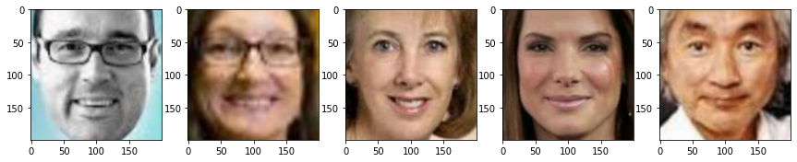

Slide 5
Collection of Images
Male
Female
Filter ‘Age’ group from 20 to 70

Slide 6
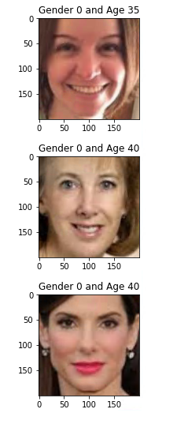
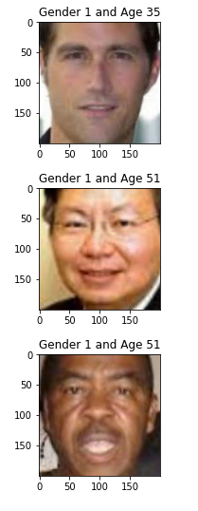

Slide 7
Collection 1: Pictures of summer season landscapes.
Collection 2: Pictures of winter months landscapes.
GAN 1: Translates images of summer season (collection 1) to winter months (collection 2).
GAN 2: Translates images of winter months (collection 2) to summer season (collection 1).
Generator Version 1:
Input: Takes images of summer season (collection 1).
Outcome: Creates images of winter months (collection 2).
Discriminator Version 1:.
Input: Takes images of winter months from collection 2 as well as outcome from Generator Version 1.
Outcome: Chance of picture is from collection 2.
Generator Version 2:.
Input: Takes images of winter months (collection 2).
Outcome: Creates images of summer season (collection 1).
Discriminator Version 2:.
Input: Takes images of summer season from collection 1 as well as outcome from Generator Version 2.
Outcome: Chance of picture is from collection 1.
1

Slide 8
Onward Cycle Uniformity Loss:.
Input image of summer season (collection 1) to GAN 1
Outcome image of winter months from GAN 1
Input image of winter months from GAN 1 to GAN 2
Outcome image of summer season from GAN 2
Contrast image of summer season (collection 1) to image of summer season from GAN 2
In Reverse Cycle Uniformity Loss:.
Input image of winter months (collection 2) to GAN 2
Outcome image of summer season from GAN 2
Input image of summer season from GAN 2 to GAN 1
Outcome image of winter months from GAN 1
Contrast image of winter months (collection 2) to image of winter months from GAN

Slide 9
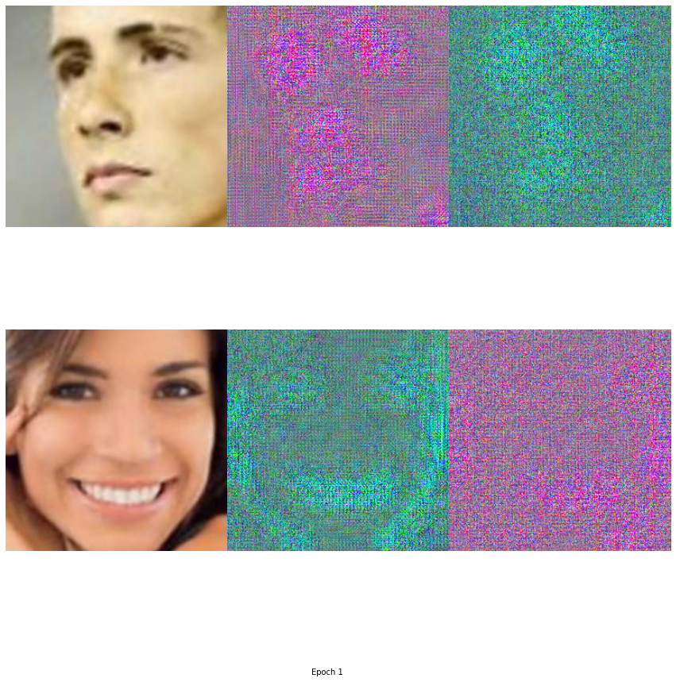

Slide 10
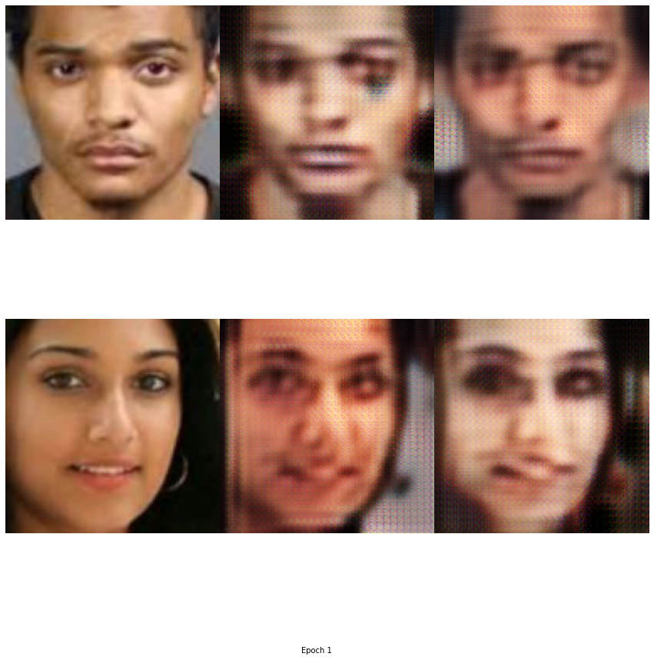
100%
236/236 [32:04<00:00, 8.15s/it]
Epoch [1/100], Step [1/236],
Discriminator_A_losses: 0.7786,
Discriminator_B_loss: 0.6268,
Generator_A_loss: 1.1148,
Generator_B_loss: 1.4634
Epoch [1/100], Step [101/236],
Discriminator_A_losses: 0.1777,
Discriminator_B_loss: 0.1618,
Generator_A_loss: 0.3874,
Generator_B_loss: 0.4348
Epoch [1/100], Step [201/236],
Discriminator_A_losses: 0.1444,
Discriminator_B_loss: 0.1850,
Generator_A_loss: 0.6305,
Generator_B_loss: 0.4485

Slide 11
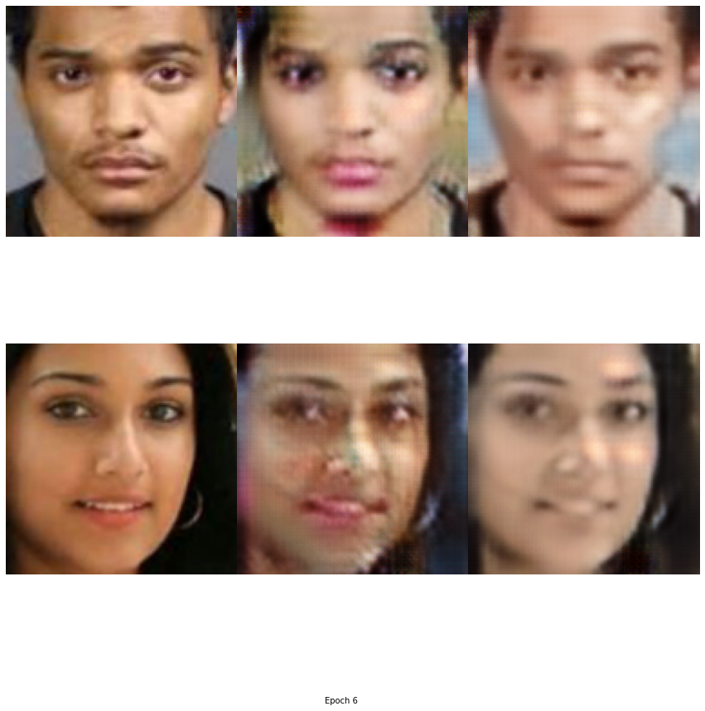
100%
236/236 [01:31<00:00, 2.57it/s]
Epoch [5/100], Step [1/236],
Discriminator_A_losses: 0.1527,
Discriminator_B_loss: 0.1267,
Generator_A_loss: 0.4968,
Generator_B_loss: 0.3262
Epoch [5/100], Step [101/236],
Discriminator_A_losses: 0.1517,
Discriminator_B_loss: 0.1773,
Generator_A_loss: 0.2407,
Generator_B_loss: 0.5700
Epoch [5/100], Step [201/236],
Discriminator_A_losses: 0.1561,
Discriminator_B_loss: 0.1838,
Generator_A_loss: 0.5190,
Generator_B_loss: 0.2752

Slide 12
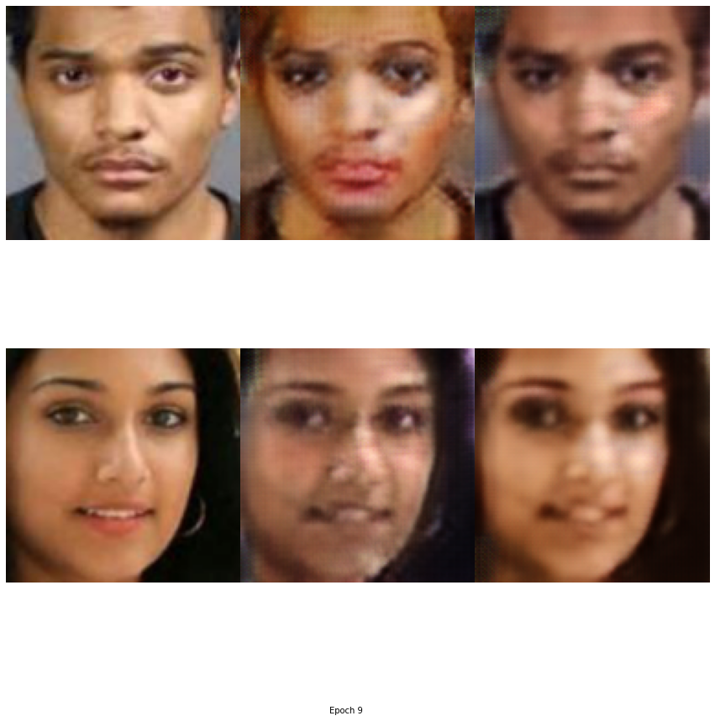
236/236 [01:21<00:00, 2.88it/s]
Epoch [8/100], Step [1/236],
Discriminator_A_losses: 0.1340,
Discriminator_B_loss: 0.1680,
Generator_A_loss: 0.3249,
Generator_B_loss: 0.2611
Epoch [8/100], Step [101/236],
Discriminator_A_losses: 0.0709,
Discriminator_B_loss: 0.1250,
Generator_A_loss: 0.3755,
Generator_B_loss: 0.5953
Epoch [8/100], Step [201/236],
Discriminator_A_losses: 0.0838,
Discriminator_B_loss: 0.1699,
Generator_A_loss: 0.2567,
Generator_B_loss: 0.6284

